Slide 1
L02 – Scrum
FIT2101: Software Engineering Process and Management
S2 2020

Slide 2
In this lecture…
What is Scrum?
Scrum stakeholders
Scrum teams
Scrum Masters
Product Owners
The Scrum team in context

Slide 3
What is Scrum?
Scrum is an iterative, incremental framework for projects and product or application development.
– The Scrum Primer
So:
It's not a programming method
It's not even specific to IT
It's a way to organize groups of people to deliver something

Slide 4
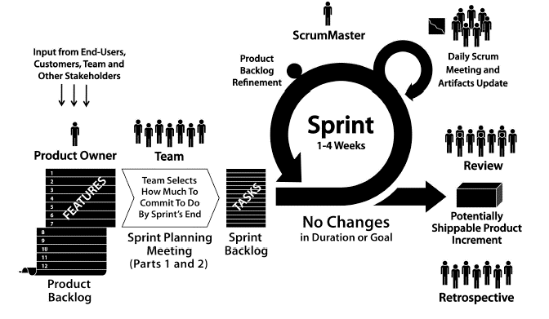
Scrum in one picture
Notes:
Note no mention of programming – this is because Scrum is a methodology for making things-in-general, and software is just one kind of thing.

Slide 5
Explaining the picture
The product owner talks to everybody involved with the project, figures out what they want, and puts their requirements into a product backlog (list of desired features)
this isn’t a once-off activity but can continue throughout development
At the start of each iteration, the team collectively decides how much of the product backlog they will implement
this goes into a sprint backlog
The team implements features from the sprint backlog until either the sprint is over or they run out of features to implement
daily standup meeting during sprint ensures that team members know what everybody is up to and who’s in need of help
After the sprint
product review, often with Product Owner
retrospective meeting: can we make our process more efficient?
Notes:
All the terms with red highlighting will be explained in more detail over the next few weeks.

Slide 6
More information about Scrum practices will be found in the readings
so that it will be easy for you to refer to it
Right now, we’ll look at the stakeholders of a Scrum project

Slide 7
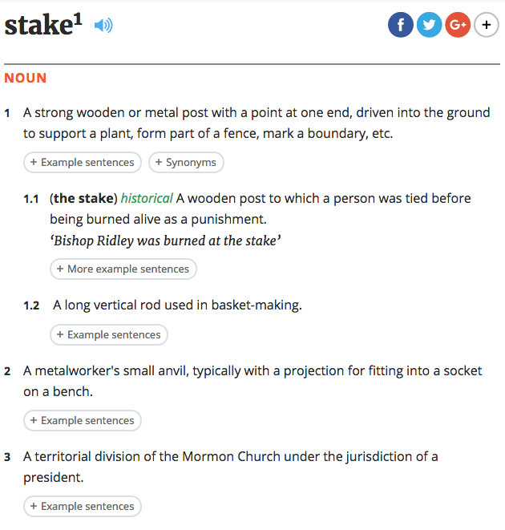
What is a stakeholder?
Notes:
Definitions from en.oxforddictionaries.com.
We are not talking about wooden stakes, or metalworking stakes, or Mormon stakes.

Slide 8
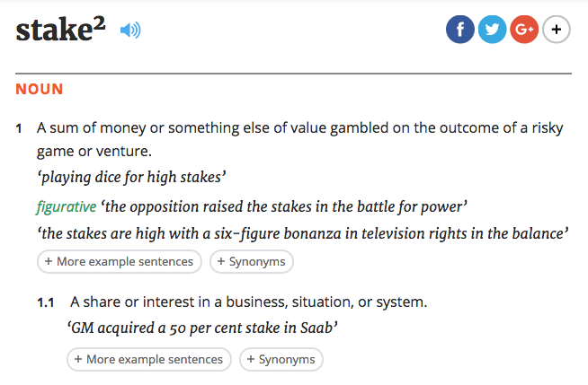
What is a stakeholder?
✓
Notes:
We are talking about having an interest in a situation, especially a financial interest.

Slide 9
Stakeholders
The team
Scrum Master
Product Owner
team members
7 +/- 2 people
Client or customer
other stakeholders
Other people in your organization
teams that use your products
senior management and executives
Notes:
You might have complicated relationships with other parts of your organization. Perhaps you’re working for a company that produces COTS (shrinkwrap) software and sells it. Your team might need to deal with sales and marketing, production, accounting, human resources, technical support/helpdesk, technical writers, etc. That’s a lot of stakeholders to satisfy, which is one reason that the Scrum Master’s role includes managing interference from outside the team.

Slide 10
People in the Scrum team

Slide 11
The team
7 +/- 2 people
Contains all the skills needed to build the product (cross-functional)
Self-managing
100% dedicated to the team’s task (at work, at least)
they work on one project at a time, so they can maintain concentration
they shouldn’t be moving around from project to project
Ideally, working in the same room or very close by
can build up relationships and tacit knowledge, i.e. get to the point where team members will immediately know who to talk to when a problem arises
Notes:
The “7 +/- 2” figure comes from cognitive science – it’s the number of things that most people can hold simultaneously in their working memory. Consequently, it’s a good size for a self-managing team: it’s large enough to get stuff done but small enough that you don’t have to resort to paper methods in order to understand who’s supposed to be doing what.

Slide 12
Scrum master
Not the same as a traditional Project Manager
Biggest difference: helps team come to consensus rather than making decisions and issuing commands
Similar responsibilities in non-Scrum projects might fall to someone called and Agile Coach or even a Project Manager
Project role: stopping things from interfering with the project
anger/arguments within the team
inability to come to a decision
lack of resources
interruptions from outside
A servant-leader

Slide 13
Servant leadership
Leadership and organization are services that the Scrum Master provides to the project
Supports decisions of team and Product Owner rather than issuing commands
Helps team understand Agile/Scrum principles and how they impact on team activities
helps team members who are new to Agile learn what to do
Organizes sprint activities
product review
retrospective
Makes sure team and Product Owner understand each other
Helps Product Owner manage backlog
makes sure they understand it well enough to maximize value
helps select priorities for sprint
Notes:
A Scrum Master whose main concern is the obedience of the team rather than their well-being is bad at their job. In traditional command-and-control management, obedience to management decisions is a prerequisite for team functioning.

Slide 14
Facilitation
The word facilitate means to make easy
Scrum Masters should make collaboration easy
Scrum masters need to be able to facilitate interactions (e.g. meetings)
make sure everybody’s voice is heard
stimulate discussion if it flags
prevent discussion from degenerating into argument
help team achieve consensus rather than making all the decisions
your workshop facilitators should be doing similar things! (hence the name)
Notes:
In a way, being a facilitator is the opposite of being a “boss”. Instead of issuing commands, the Scrum Master should spend a great deal of time listening to other participants.

Slide 15
Product Owners
Responsible for deciding the content of the product backlog
Responsible for deciding the priority of each backlog entry
The Product Owner should decide what goes into the product backlog on the basis of business value/Return On Investment (ROI)

Slide 16
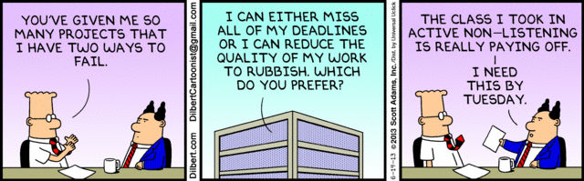
Product Owners and business value
A common friction point between engineers and business types:
do it properly (and take time) vs. get it done NOW (and do a sloppy job)
Frequent theme of Dilbert cartoons…

Slide 17
The Product Owner
Product Owner may be customer, or a representative of customers, or internal staff member
The Product Owner tells the team what to build for each iteration
The Product Owner is one person
arguments between Product Owners would be bad…
Where they get their information from is beyond the scope of Scrum
team gives them technical info but as far as their product knowledge is concerned, the process model doesn’t care
They are responsible for maintaining the product backlog
Notes:
We’ll look at Product Owners and their relationship to the team next week.

Slide 18
Creating the Product Backlog
The Product Owner is supposed to be the resident expert on what stakeholders want and need
should understand the business environment and users
The team helps the Product Owner make decisions
the team can estimate how long various different options will take to implement
the team should be able to estimate technical risks involved
the team understand dependencies between features
But the Product Owner has the final say, subject to what the team says is feasible

Slide 19
Team members
Agile teams are self-managing
day-to-day tasks are not assigned by an external manager
Agile teams should be cross-functional
not just coders, but testers, designers, etc.
helps if team members have more than one skill
Ideally, no formal structure
the team decides collectively who will do what on each sprint
Notes:
Note that “cross-functional” doesn’t mean that everybody has to be able to do everything. If you require this of your entire team, you might have maximum flexibility but you’re going to have a very hard time finding suitable staff. Having said that, though, the more multiskilled people you have on your team, the easier it will be to plan each sprint. You’ll have more options.

Slide 20
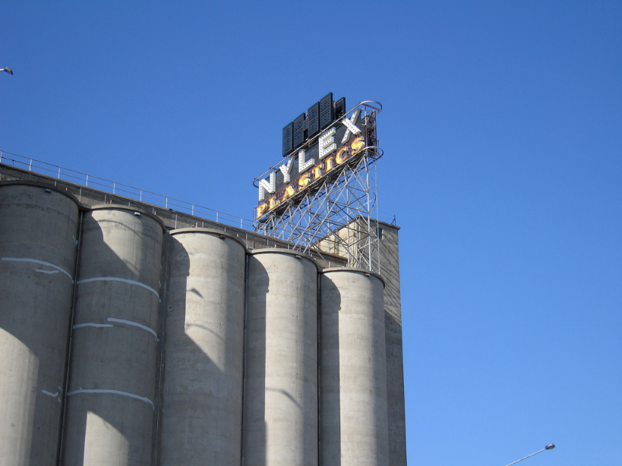
Silos
In business, a silo is a system or group that has sole access to a particular skillset or kind of data
e.g. only QA team know about QA, only DBAs know about databases, etc.
Potential source of problems in Agile teams
what will the team’s DBA do if a sprint doesn’t touch the database?
what happens if the sprint requires more database work than one person can do?
so team might waste developer time, or struggle to complete sprint backlog
Agile teams need to guard against siloing
it’s okay to have specialists on the team
but they have to be open to sharing their skills and knowledge with teammates
and also to learning new skills and knowledge
build some time for training into sprint plans
Notes:
A silo mentality can easily arise in an organization that is build along traditional, functional lines. If members of the “QA team” think of themselves as QA first and project team members second, they won’t be motivated to be good team players – their loyalties are divided between their functional group and their project group. In this situation it’s all too easy for them to lose motivation to do their best for the project.
If Dave sets himself up as the team’s “SQL Guy”, that’s going to have three effects: firstly, Dave immediately becomes a single point of failure for any project requiring SQL. He won’t be able to go on leave lest these projects fall behind, and heaven help the organization if he gets sick. Secondly, the rest of the team is deprived of an opportunity to build their skills in SQL. Thirdly, if there’s a lot of SQL programming to do in any particular sprint and Dave can’t keep up with it, the team will fall short on that sprint. All of these problems are common in project management, and following Agile principles properly goes a long way to mitigate these risks.
Malaysia folk (and visitors to Melbourne): the image shows the Nylex Clock on top of the old malting storage silos at Cremorne in Melbourne. This clock is visible from many parts of Melbourne including main road and rail approaches from the east, and is a significant Melbourne landmark. When functioning, it alternates between displaying the current time and the current temperature; however it has not been in operation since Nylex ceased operations in 2007. Wikipedia has a page about it here: https://en.wikipedia.org/wiki/Nylex_Clock

Slide 21
Flexibility and responsibility
Potential problem in self-organizing teams: making sure everything gets done
in conventional team, Project Manager does this
not really Scrum Master’s role; Scrum Master should aid rather than command
Ideally, everything that needs to be done goes into project backlog, then into sprint backlog
team self-selects tasks from sprint backlog
but what if something is overlooked?
It can be a good idea to have somebody check that things are put into the backlog
So the team can assign roles to its members to mitigate this risk
a role isn’t a job or a position, it’s a collection of responsibilities
don’t have to do it yourself, just check that it’s in the backlog and somebody is doing it
team members can have multiple roles, and can change roles during development if needed
good idea to rotate through roles to prevent siloing
think of this as quality assurance for your development process
Notes:
Scene from a second year Software Engineering marking interview some years ago: “I thought you were going to write the Test Plan!”
It’s true that the team should be self-organizing. It’s equally true that individuals shouldn’t define exclusive roles for themselves that preclude them from participating in development in any other way, or deny colleagues the ability to take on their favoured role. But that doesn’t mean that the team can’t allocate responsibilities, especially responsibilities for ensuring work is done rather than doing it themselves. This could form part of the Scrum Master’s duties, but then there’s a chance she could end up handing out tasks like a traditional Project Manager – which of course means that she becomes a potential bottleneck.

Slide 22
Stakeholders outside the team

Slide 23
Internal stakeholders
Agile teams may be part of a larger organization or company
May need to deal with other parts of the company
senior management
HR
Accounting
IT support
other specialists to provide one-off help
other teams working on related products
It is part of the Scrum Master’s role to
defend the team against interference from outside
arrange for support and resources as needed
represent the team to the rest of the organization (so that the team members don’t have to be dragged into meetings).
Notes:
Defending against interference can be very challenging in an organization that is new to Agile practices. In particular, the idea that team members need to be allocated 100% to the team they’re on can cause problems when managers are used to allocating fractions of people’s time to different projects. However, switching back and forth between projects is a source of cognitive friction – it eats up time and attention, and it’s pure overhead. Nothing is gained by it other than management convenience, and significant productivity can be lost, especially if the team member has to switch frequently. Besides, it doubles the likelihood that the team member is going to be interrupted while doing something productive.

Slide 24
Clients, customers, and end users
Many interested stakeholders outside your organization
people who will pay for your product
people who make decisions about whether to use/purchase your product
people who will use your product
Ideally, you want to satisfy all of these people
Software Engineering books sometimes roll all these stakeholders together and refer to them as clients, but it is more complicated than that
Notes:
I’m usually going to use “client” and “customer” interchangeably.

Slide 25
Contract development
Your organization is producing a product for an external client
The client may be an individual or an organization
The client is responsible for defining software requirements
Product Owner in this case is either somebody from the client organization or somebody from your organization who has a strong working relationship with it
Notes:
Todo: diagrammatic representation

Slide 26
Contract development
Team
Product Owner
End users, management, and other stakeholders in the client’s organization talk to the Product Owner
Product Owner talks to the team, represents those stakeholders’ interests

Slide 27
Product development
Your organization is building a software product that you plan to sell (or distribute)
end users are still outside your organization
but no “client” as such
Typical Product Owner in this case is within your organization
but is very much concerned with understanding potential purchasers of the software
Notes:
These slides were added to FIT2101 at the request of a local (shrinkwrap) software company, who noted that our graduates were assuming that there would always be a “client” and getting confused about the role of product engineering and product management. They asked us to make sure our Software Engineering graduates are familiar with other ways to develop software apart from contracting.

Slide 28
Product development
Team
Potential users
Current users
Product Owner
Product owner represents the interests of potential users
Also communicates with and represents current users, if a version has already been released
Needs to consider the interests of internal groups: Marketing, Support, etc.
Notes:
In this situation, the Product Owner might be a specialist in marketing, product development, or user experience.

Slide 29
In-house development
Your team produces software that is used by other teams that are part of the same organization
Product Owner is usually (but not always) a user representative from outside your team

Slide 30
In-house development
Team
Product Owner
Product Owner, team, end users are all part of the same organization or company
Still the PO’s responsibility to liaise between team and stakeholders
Notes:
I’m told by friends in industry that in-house end users are just as bothersome as external end users, so you do still need a Product Owner to make sure that the team isn’t disrupted by them.

Slide 31
Summary
Scrum
Scrum people
Scrum Master
Product Owner
Team members
Other stakeholders

Slide 32
Next week
Beginning your project: Agile inception

